Slide 1
Name:- Anasemoon Nasr Gamil Gerges
Project:- Courses System
Telephone:- 01282618905
Email:- Anasemoon_2012@yahoo.com

Slide 2
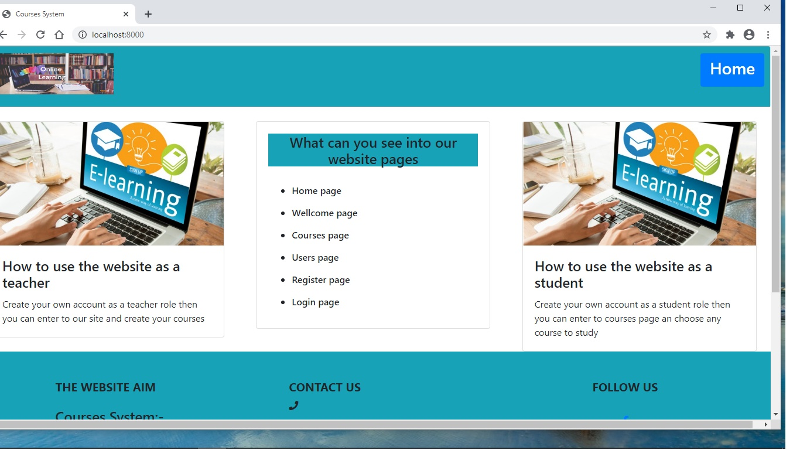
Welcome page:- first page you can see it have some information about my website and how to contact with me it has home button when you click it you will enter to home page

Slide 3
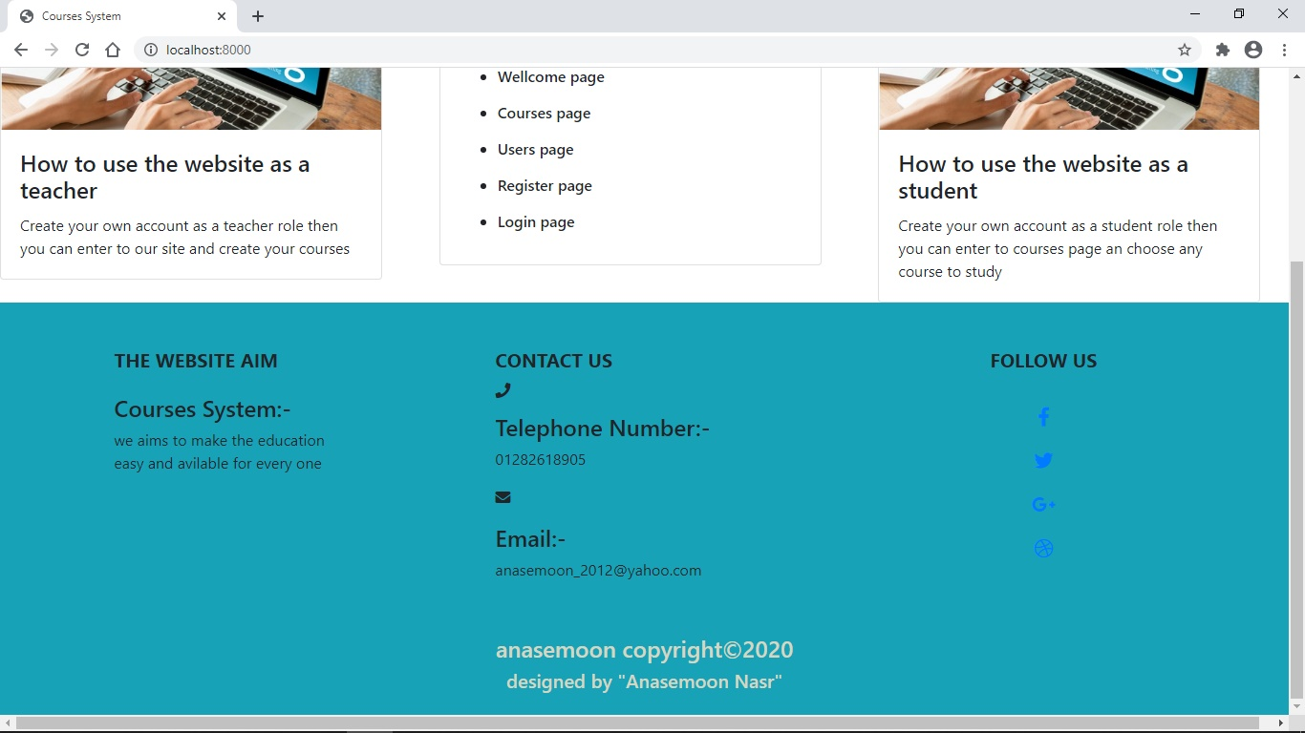

Slide 4
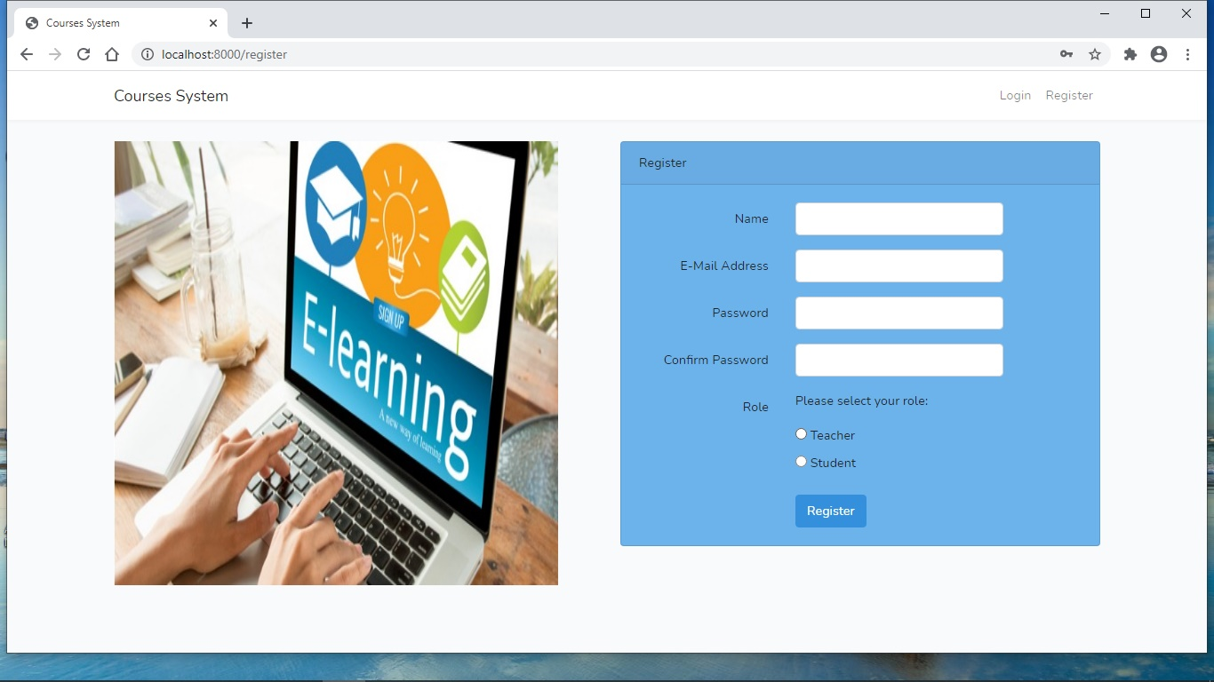
Register page:- you can create your new user account as a student or as a teacher to be able to access the website

Slide 5
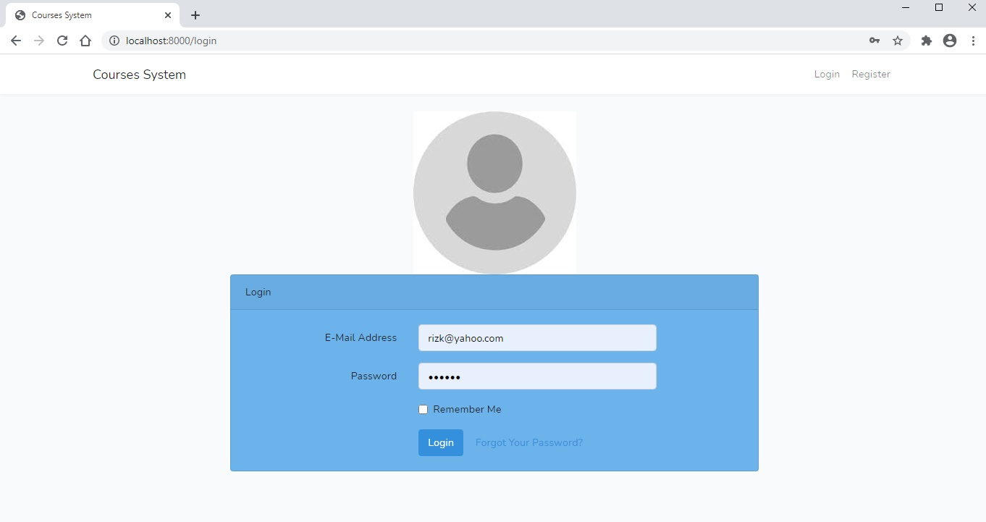
login page:- you have to login first by your email and password to be able to enter the website

Slide 6
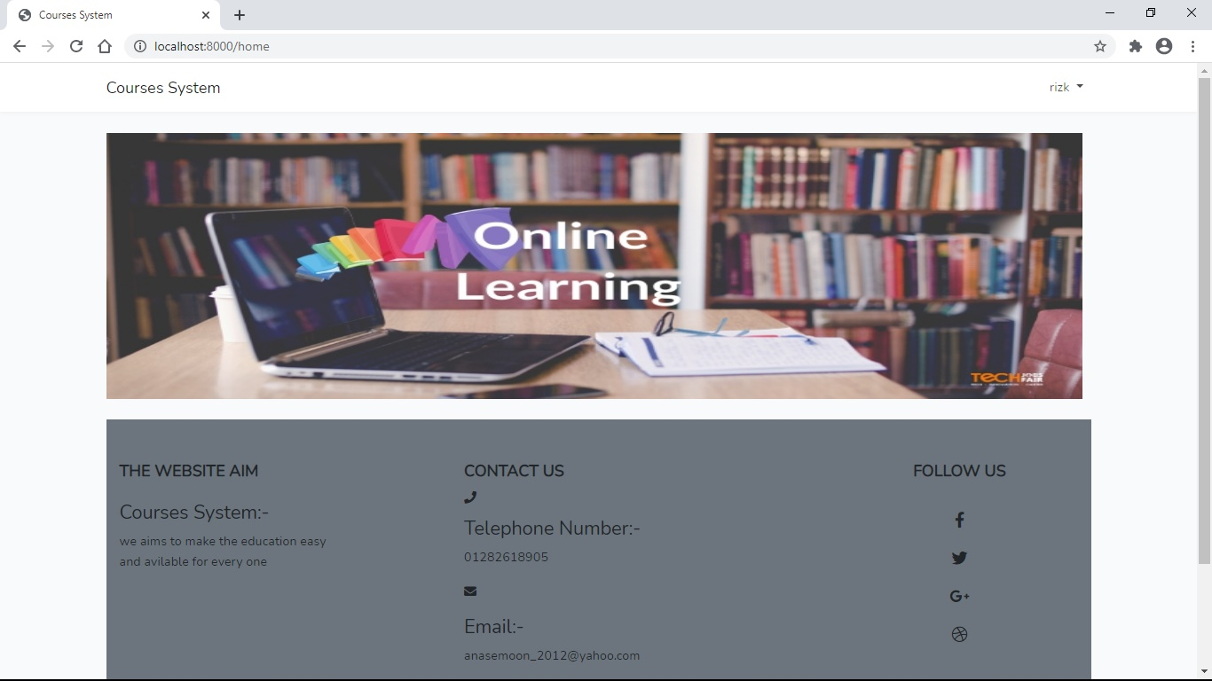
Home page:- it contains some data about me and my site and also contains dropdown menu with important website pages

Slide 7
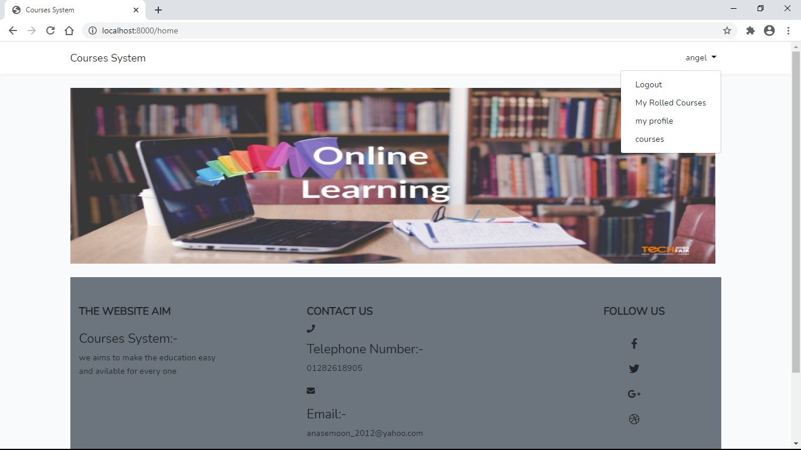
Student home:- it appears to student user

Slide 8
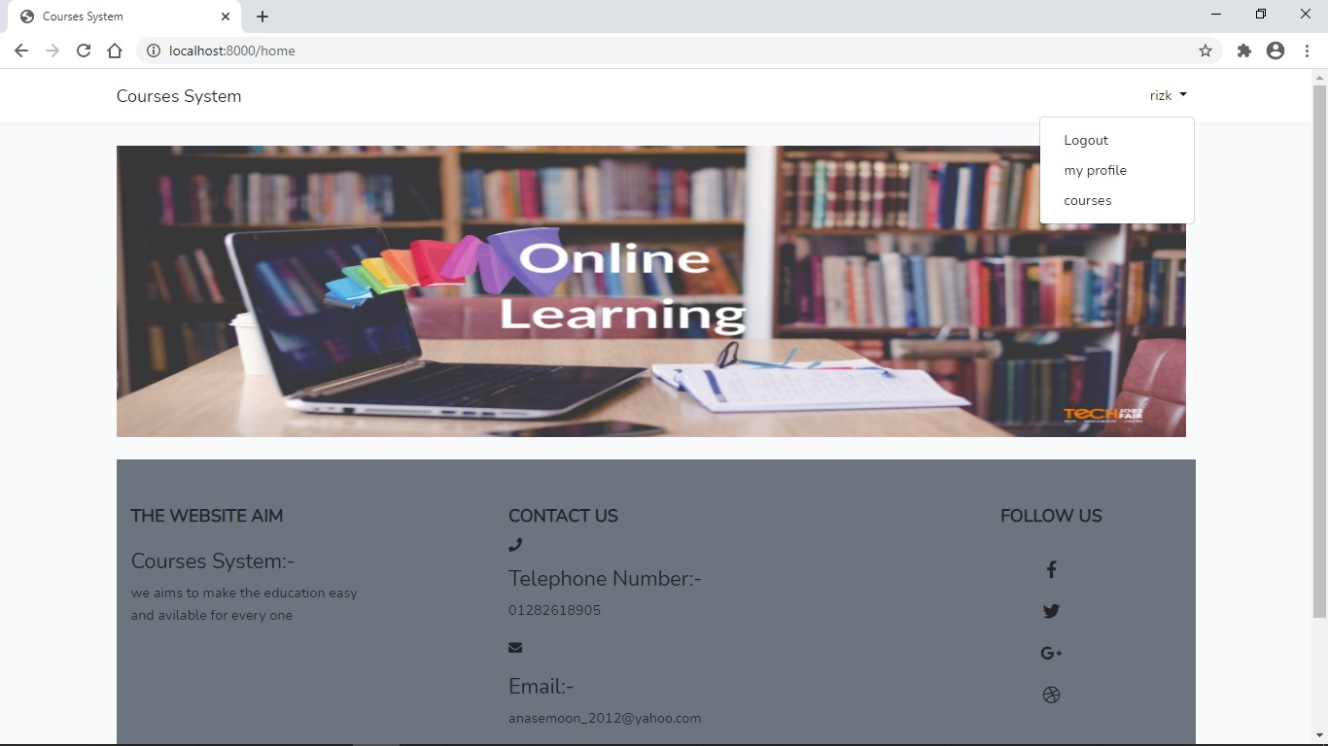
Teacher home:- it appears to teacher user

Slide 9
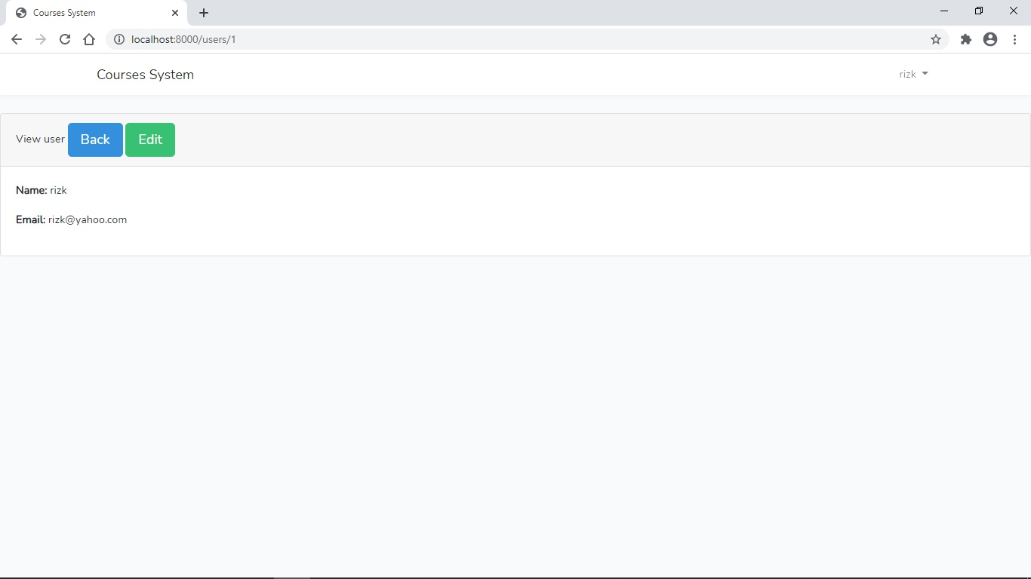
User profile:- it contains your personal information as name and email, you can also edit in it , when you press back button you will return to courses page

Slide 10
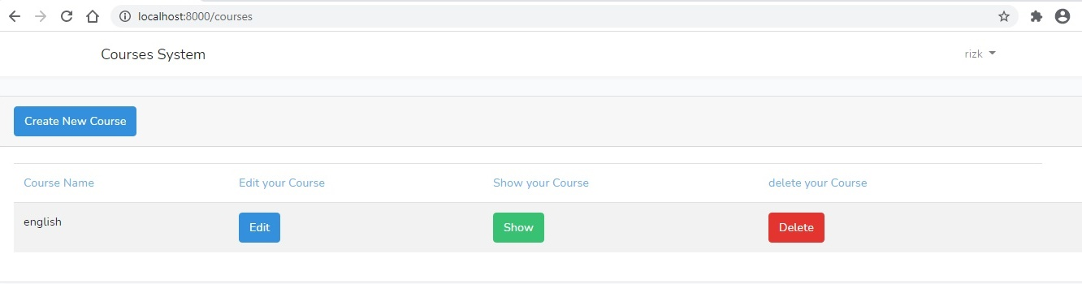
Teacher courses:- teacher can only see and edit or delete his own courses, teacher can create new course

Slide 11
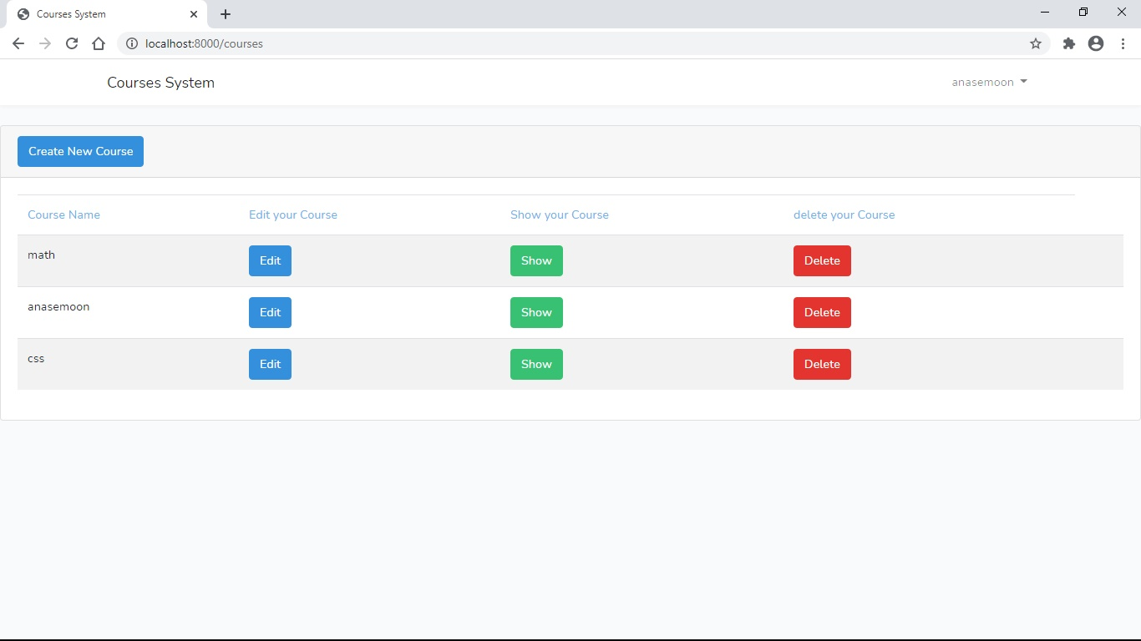
Another teacher courses:-

Slide 12
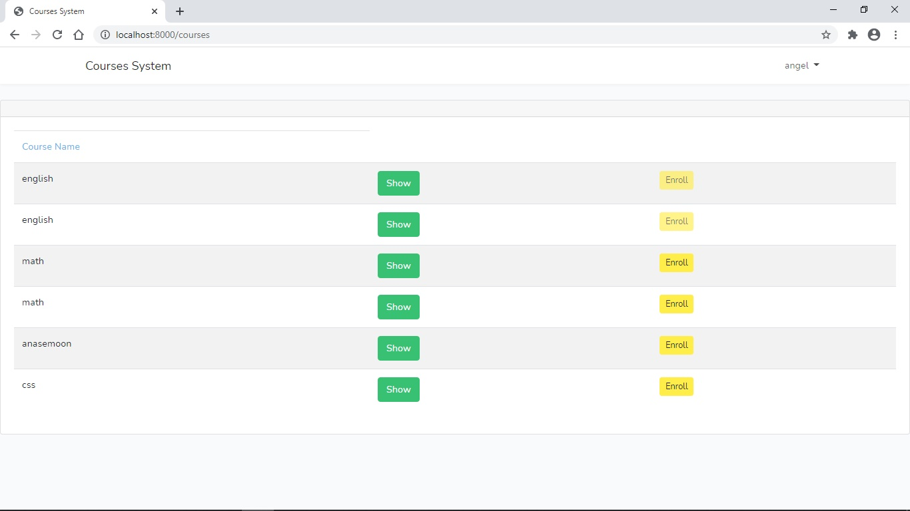
Student courses:- student can show all courses that created by teachers and also can enroll any course, when student enroll any course it will be disappeared in enroll button for him

Slide 13
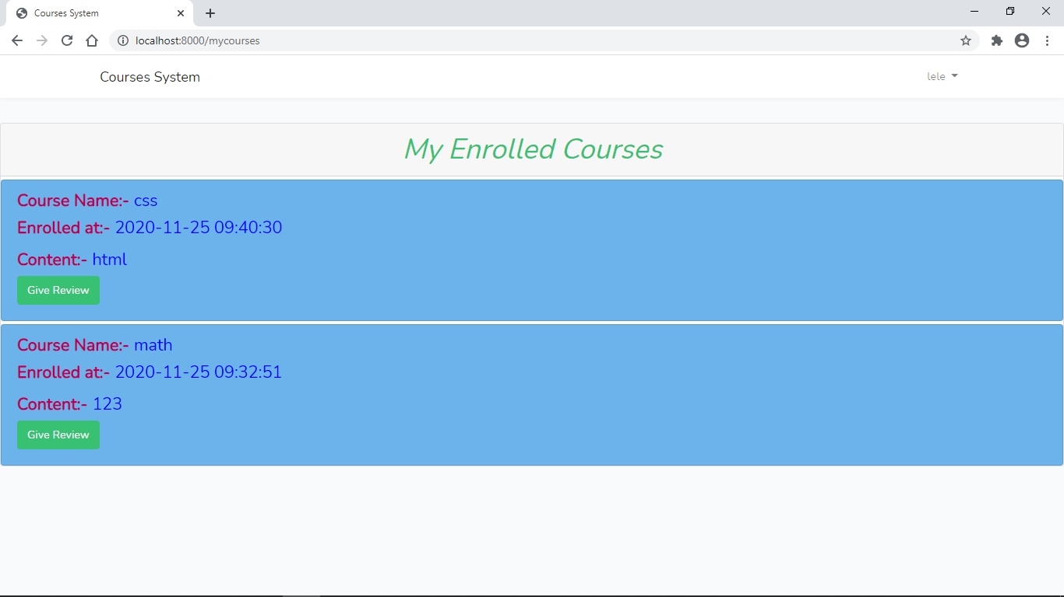
My enrolled courses:- it contains courses that student has enrolled and the time it was enrolled at

Slide 14
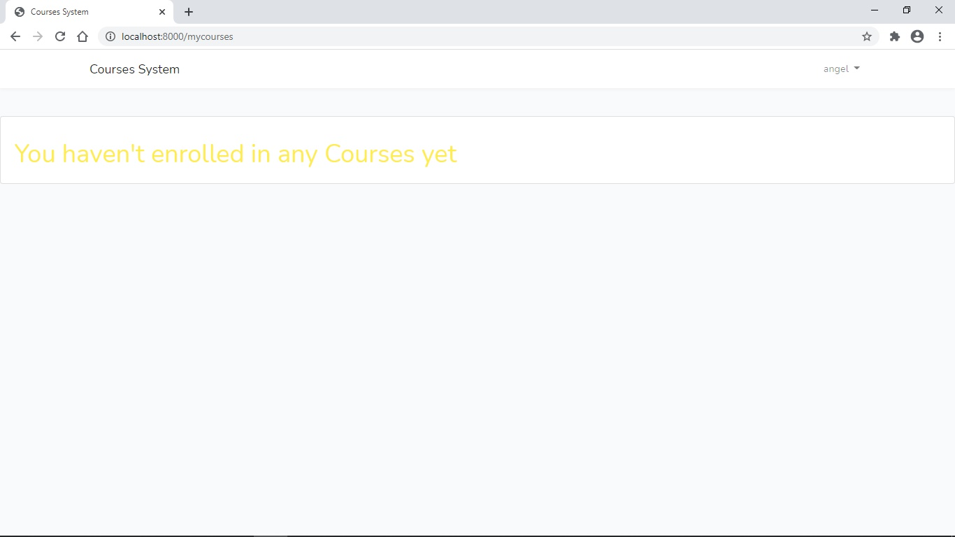
If student did not enroll any course

Slide 15
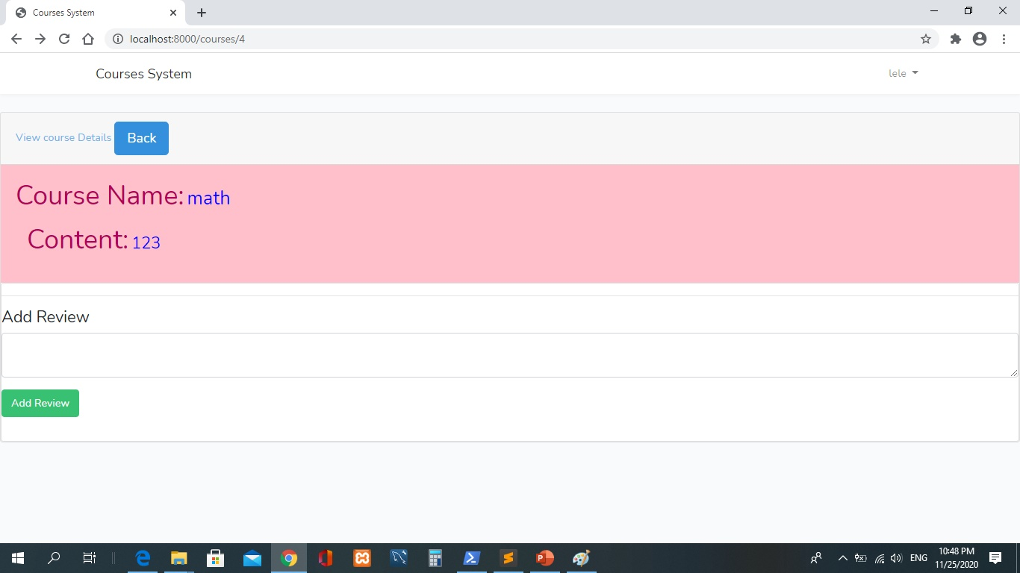
Student course Show :- student can show course details and add reviews to the courses

Slide 16
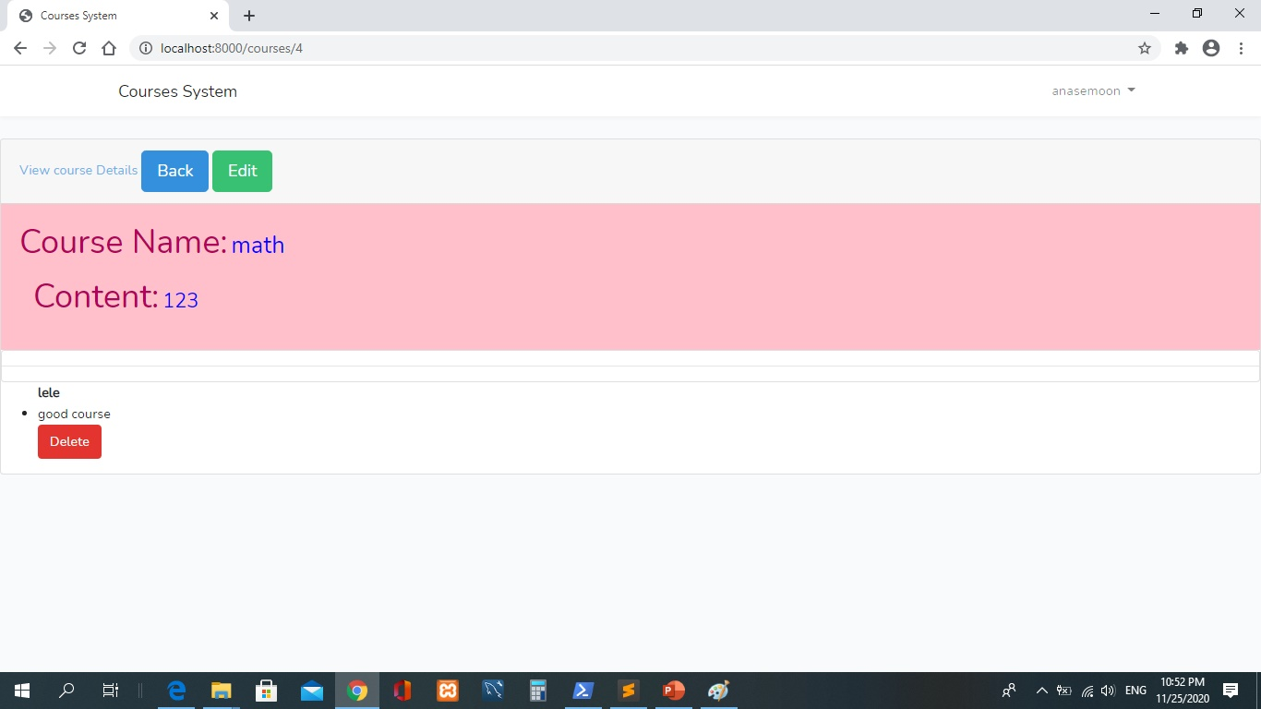
Teacher course Show :- teacher can only show reviews into his courses he can not add reviews and also he can edit into his course details

Slide 17
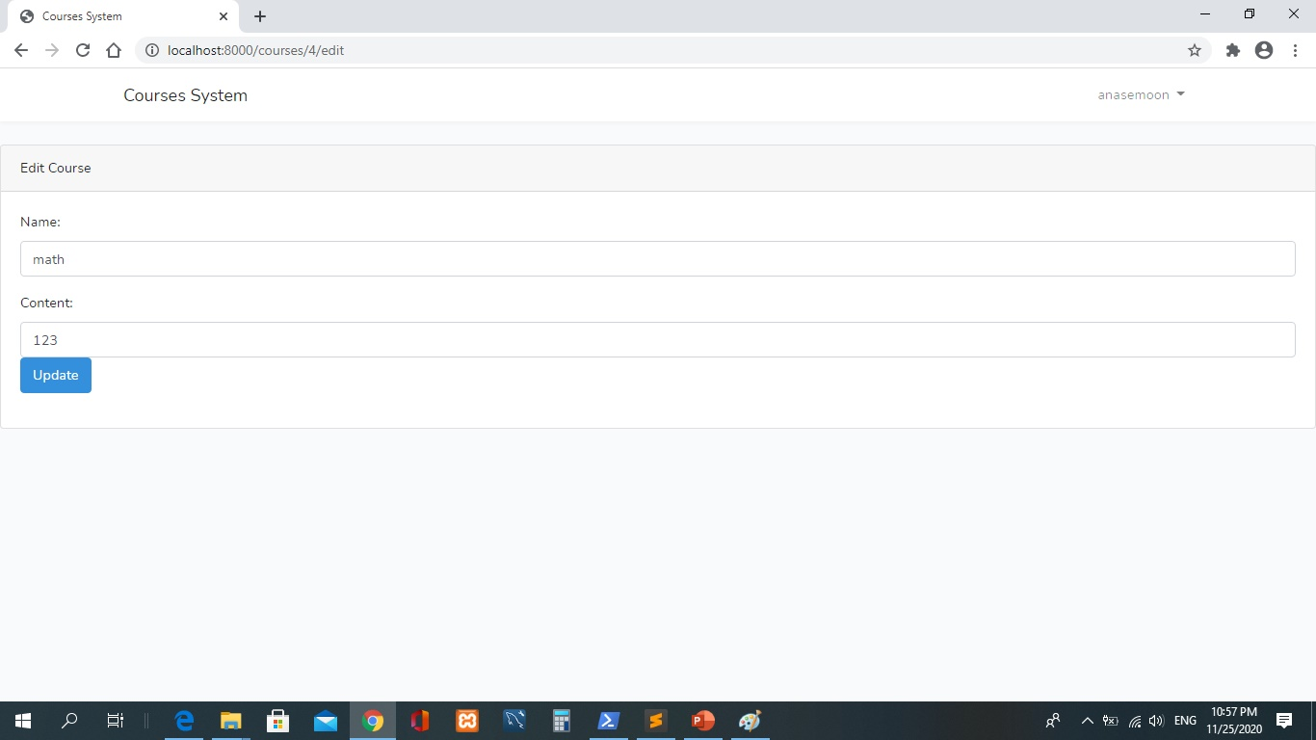
Edit course:- only teachers can edit the course details

